Slide 1
Cryptography and Network Security
DIFFIE HELLMAN KEY EXCHANGE

Slide 2
Session Meta Data
Author | Dr T Sree Sharmila
Reviewer
Version Number | 1.0
Release Date | 6 July 2018

Slide 3
Revision History
Revision Date | Details | Version no.
 |  | 1.0

Slide 4
Agenda
Introduction
Diffie-Hellman key exchange
Diffie-Hellman example
Diffie-Hellman protocol
Man-in-the-middle attack
Summary
Test your understanding
References

Slide 5
Introduction
Amongst the tribes of Central Australia every man, woman, and child has a secret or sacred name which is bestowed by the older men upon him or her soon after birth, and which is known to none but the fully initiated members of the group. This secret name is never mentioned except upon the most solemn occasions; to utter it in the hearing of men of another group would be a most serious breach of tribal custom. When mentioned at all, the name is spoken only in a whisper, and not until the most elaborate precautions have been taken that it shall be heard by no one but members of the group. The native thinks that a stranger knowing his secret name would have special power to work him ill by means of magic.
—The Golden Bough, Sir James George Frazer
Notes:
5
Opening quote.

Slide 6
Agenda
Introduction
Diffie-Hellman key exchange
Diffie-Hellman example
Key exchange protocol
Man-in-the-middle attack
Summary
Test your understanding
References

Slide 7
Diffie-Hellman Key Exchange
first public-key type scheme proposed
by Diffie & Hellman in 1976 along with the exposition of public key concepts
note: now know that Williamson (UK CESG) secretly proposed the concept in 1970
is a practical method for public exchange of a secret key
used in a number of commercial products
Notes:
7
This chapter continues our overview of public-key cryptography systems (PKCSs), and begins with a description of one of the earliest and simplest PKCS, Diffie-Hellman key exchange. This first published public-key algorithm appeared in the seminal paper by Diffie and Hellman that defined public-key cryptography [DIFF76b] and is generally referred to as Diffie-Hellman key exchange. The concept had been previously described in a classified report in 1970 by Williamson (UK CESG) - and subsequently declassified in 1987, see [ELLI99]. The purpose of the algorithm is to enable two users to securely exchange a key that can then be used for subsequent encryption of messages. The algorithm itself is limited to the exchange of secret values. A number of commercial products employ this key exchange technique.

Slide 8
Diffie-Hellman Key Exchange
a public-key distribution scheme
cannot be used to exchange an arbitrary message
rather it can establish a common key
known only to the two participants
value of key depends on the participants (and their private and public key information)
based on exponentiation in a finite (Galois) field (modulo a prime or a polynomial) - easy
security relies on the difficulty of computing discrete logarithms (similar to factoring) – hard
Notes:
8
The purpose of the algorithm is to enable two users to securely exchange a key that can then be used for subsequent encryption of messages. The algorithm itself is limited to the exchange of secret values, which depends on the value of the public/private keys of the participants. The Diffie-Hellman algorithm uses exponentiation in a finite (Galois) field (modulo a prime or a polynomial), and depends for its effectiveness on the difficulty of computing discrete logarithms.

Slide 9
Diffie-Hellman Setup
all users agree on global parameters:
large prime integer or polynomial q
a being a primitive root mod q
each user (eg. A) generates their key
chooses a secret key (number): x_{A} < q
compute their public key: y_{A} = a^{xA} mod q
each user makes public that key y_{A}
Notes:
9
In the Diffie-Hellman key exchange algorithm, there are two publicly known numbers: a prime number q and an integer a that is a primitive root of q. The prime q and primitive root a can be common to all using some instance of the D-H scheme. Note that the primitive root a is a number whose powers successively generate all the elements mod q. Users Alice and Bob choose random secrets x's, and then "protect" them using exponentiation to create their public y's. For an attacker monitoring the exchange of the y's to recover either of the x's, they'd need to solve the discrete logarithm problem, which is hard.

Slide 10
Diffie-Hellman Key Exchange
shared session key for users A & B is K_{AB}:
K_{AB} = a^{xA.xB} mod q
= y_{A}^{xB} mod q (which B can compute)
= y_{B}^{xA} mod q (which A can compute)
K_{AB} is used as session key in private-key encryption scheme between Alice and Bob
if Alice and Bob subsequently communicate, they will have the same key as before, unless they choose new public-keys
attacker needs an x, must solve discrete log
Notes:
10
The actual key exchange for either party consists of raising the others "public key' to power of their private key. The resulting number (or as much of as is necessary) is used as the key for a block cipher or other private key scheme. For an attacker to obtain the same value they need at least one of the secret numbers, which means solving a discrete log, which is computationally infeasible given large enough numbers. Note that if Alice and Bob subsequently communicate, they will have the same key as before, unless they choose new public-keys.

Slide 11
Agenda
Introduction
Diffie-Hellman key exchange
Diffie-Hellman example
Key exchange protocol
Man-in-the-middle attack
Summary
Test your understanding
References

Slide 12
Diffie-Hellman Example
users Alice & Bob who wish to swap keys:
agree on prime q=353 and a=3
select random secret keys:
A chooses x_{A}=97, B chooses x_{B}=233
compute respective public keys:
y_{A}=3⁹⁷ mod 353 = 40 (Alice)
y_{B}=3²³³ mod 353 = 248 (Bob)
compute shared session key as:
K_{AB}= y_{B}^{xA} mod 353 = 248⁹⁷ = 160 (Alice)
K_{AB}= y_{A}^{xB} mod 353 = 40²³³ = 160 (Bob)
Notes:
12
Here is an example of Diffie-Hellman from the text using prime q=353, showing how each computes its public key, and then how after they exchange public keys, each can compute the common secret key.I n this simple example, it would be possible by brute force to determine the secret key 160. In particular, an attacker E can determine the common key by discovering a solution to the equation 3ª mod 353 = 40 or the equation 3^{b} mod 353 = 248. The brute-force approach is to calculate powers of 3 modulo 353, stopping when the result equals either 40 or 248. The desired answer is reached with the exponent value of 97, which provides 3⁹⁷ mod 353 = 40. With larger numbers, the problem becomes impractical.

Slide 13
Agenda
Introduction
Diffie-Hellman key exchange
Diffie-Hellman example
Key exchange protocol
Man-in-the-middle attack
Summary
Test your understanding
References

Slide 14
Key Exchange Protocols
users could create random private/public D-H keys each time they communicate
users could create a known private/public D-H key and publish in a directory, then consulted and used to securely communicate with them
both of these are vulnerable to a Man-in-the-Middle Attack
authentication of the keys is needed
Notes:
14
Now consider a simple protocol that makes use of the Diffie-Hellman calculation. Suppose that user A wishes to set up a connection with user B and use a secret key to encrypt messages on that connection. User A can generate a one-time private key X_{A}, calculate Y_{A}, and send that to user B. User B responds by generating a private value X_{B}, calculating Y_{B}, and sending Y_{B} to user A. Both users can now calculate the key. The necessary public values q and a would need to be known ahead of time. Alternatively, user A could pick values for q and a and include those in the first message.

Slide 15
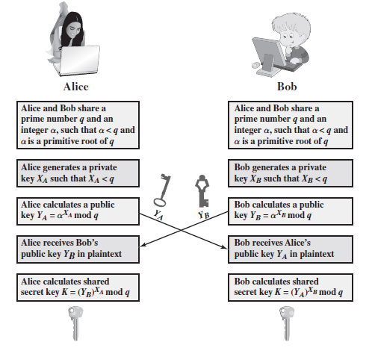
Key Exchange Protocols
Notes:
15
Now consider a simple protocol that makes use of the Diffie-Hellman calculation. Suppose that user A wishes to set up a connection with user B and use a secret key to encrypt messages on that connection. User A can generate a one-time private key X_{A}, calculate Y_{A}, and send that to user B. User B responds by generating a private value X_{B}, calculating Y_{B}, and sending Y_{B} to user A. Both users can now calculate the key. The necessary public values q and a would need to be known ahead of time. Alternatively, user A could pick values for q and a and include those in the first message.

Slide 16
Agenda
Introduction
Diffie-Hellman key exchange
Diffie-Hellman example
Key exchange protocol
Man-in-the-middle attack
Summary
Test your understanding
References

Slide 17
Man-in-the-Middle Attack
Darth prepares by creating two private / public keys
Alice transmits her public key to Bob
Darth intercepts this and transmits his first public key to Bob. Darth also calculates a shared key with Alice
Bob receives the public key and calculates the shared key (with Darth instead of Alice)
Bob transmits his public key to Alice
Darth intercepts this and transmits his second public key to Alice. Darth calculates a shared key with Bob
Alice receives the key and calculates the shared key (with Darth instead of Bob)
Darth can then intercept, decrypt, re-encrypt, forward all messages between Alice & Bob
Notes:
The protocol described on the previous slide is insecure against a man-in-the-middle attack. Suppose Alice and Bob wish to exchange keys, and Darth is the adversary. The attack proceeds as follows:
Darth prepares for the attack by generating two random private keys X_{D1} and X_{D2} and then computing the corresponding public keys Y_{D1} and Y_{D2}
Alice transmits Y_{A} to Bob.
Darth intercepts Y_{A} and transmits Y_{D1} to Bob. Darth also calculates K2 = (Y_{A} )^ X_{D2} mod q
Bob receives Y_{D1} and calculates K1=(Y_{D1} )^ X_{B} mod q
Bob transmits Y_{B} to Alice.
Darth intercepts Y_{B} and transmits Y_{D2} to Alice. Darth calculates K1=(Y_{B} )^ X_{D1} mod q
Alice receives Y_{D2} and calculates K2=(Y_{D2} )^ X_{A} mod q .
At this point, Bob and Alice think that they share a secret key, but instead Bob and Darth share secret key K1 and Alice and Darth share secret key K2. All future communication between Bob and Alice is compromised in the following way:
Alice sends an encrypted message M: E(K2, M).
Darth intercepts the encrypted message and decrypts it, to recover M.
Darth sends Bob E(K1, M) or E(K1, M'), where M' is any message. In the first case, Darth simply wants to eavesdrop on the communication without altering it. In the second case, Darth wants to modify the message going to Bob. The key exchange protocol is vulnerable to such an attack because it does not authenticate the participants. This vulnerability can be overcome with the use of digital signatures and public- key certificates.
17

Slide 18
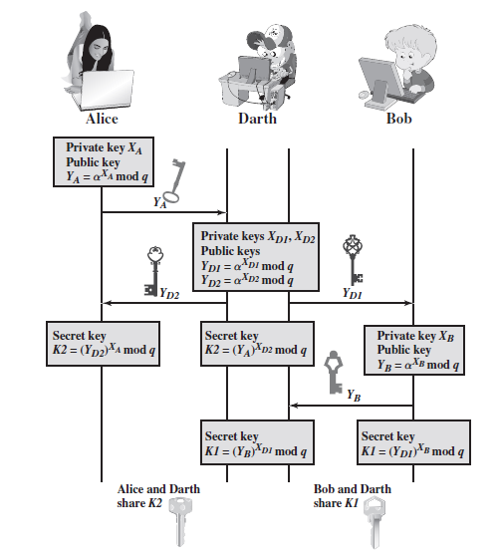
Man-in-the-Middle Attack
Notes:
The protocol described on the previous slide is insecure against a man-in-the-middle attack. Suppose Alice and Bob wish to exchange keys, and Darth is the adversary. The attack proceeds as follows:
Darth prepares for the attack by generating two random private keys X_{D1} and X_{D2} and then computing the corresponding public keys Y_{D1} and Y_{D2}
Alice transmits Y_{A} to Bob.
Darth intercepts Y_{A} and transmits Y_{D1} to Bob. Darth also calculates K2 = (Y_{A} )^ X_{D2} mod q
Bob receives Y_{D1} and calculates K1=(Y_{D1} )^ X_{B} mod q
Bob transmits Y_{B} to Alice.
Darth intercepts Y_{B} and transmits Y_{D2} to Alice. Darth calculates K1=(Y_{B} )^ X_{D1} mod q
Alice receives Y_{D2} and calculates K2=(Y_{D2} )^ X_{A} mod q .
At this point, Bob and Alice think that they share a secret key, but instead Bob and Darth share secret key K1 and Alice and Darth share secret key K2. All future communication between Bob and Alice is compromised in the following way:
Alice sends an encrypted message M: E(K2, M).
Darth intercepts the encrypted message and decrypts it, to recover M.
Darth sends Bob E(K1, M) or E(K1, M'), where M' is any message. In the first case, Darth simply wants to eavesdrop on the communication without altering it. In the second case, Darth wants to modify the message going to Bob. The key exchange protocol is vulnerable to such an attack because it does not authenticate the participants. This vulnerability can be overcome with the use of digital signatures and public- key certificates.
18

Slide 19
Agenda
Introduction
Diffie-Hellman key exchange
Diffie-Hellman example
Key exchange protocol
Man-in-the-middle attack
Summary
Test your understanding
References

Slide 20
Summary
Define Diffie-Hellman key exchange
Understand the man-in-the-middle attack
Notes:
Chapter 9 summary.

Slide 21
Agenda
Introduction
Diffie-Hellman key exchange
Diffie-Hellman example
Key exchange protocol
Man-in-the-middle attack
Summary
Test your understanding
References

Slide 22
Test your understanding
Briefly explain Diffie-Hellman key exchange.
Users A and B use the Diffie-Hellman key exchange technique with a common prime q = 71 and a primitive root a = 7.
a. If user A has private key XA = 5, what is A’s public key YA?
b. If user B has private key XB = 12, what is B’s public key YB?
c. What is the shared secret key?
Consider a Diffie-Hellman scheme with a common prime q = 11 and a primitive root a = 2.
a. Show that 2 is a primitive root of 11.
b. If user A has public key YA = 9, what is A’s private key XA?
c. If user B has public key YB = 3, what is the secret key K shared with A?

Slide 23
Agenda
Introduction
Diffie-Hellman key exchange
Diffie-Hellman example
Key exchange protocol
Man-in-the-middle attack
Summary
Test your understanding
References

Slide 24
References
1. William Stallings, Cryptography and Network Security, 6th Edition, Pearson Education, March 2013.
2. Charlie Kaufman, Radia Perlman and Mike Speciner, “Network Security”, Prentice Hall of India, 2002.

